Slide 1
Autism specific services – what ESPA believes inspectors should see where a person with autism is supported well
Michelle Elstob & Lisa Belshaw

Slide 2
About ESPA
25 years experience of supporting people across the autism spectrum, many with associated or additional difficulties or disabilities
Employing over 520 staff, supporting 194 people across the North East.
Overall Good rating in all residential services.
Strong secure and growing organisation with a £13 million turnover providing a wide range of services across the region supporting people at different stages of their life:
Day and Vocational Opportunities
Residential
Independent Specialist Further Education College
Domiciliary Agency
Transition Services
University Support Programme
Individual Service Designs
External Training and Development
Autism Works
ESPA Research

Slide 3
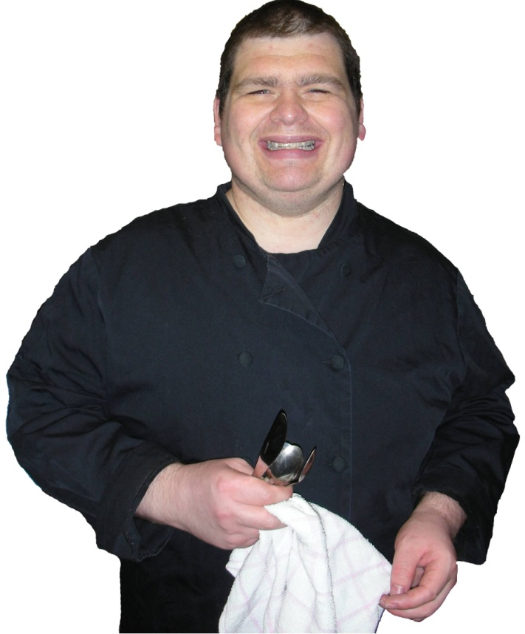
Values and Principles
Person centred and autism specific support
Focusing on the person’s needs, strengths, wishes interests and aspirations
Flexible and responsive
Value and respect each others uniqueness
Safety, health and wellbeing
Working as equal partners
Living a life they enjoy
Promoting independence
Friendships and relationships
Confidence and self esteem

Slide 4
CQC Regulations-2015

Slide 5
Reg. 9- Person-centered care
The care and treatment of service users must be:
Appropriate
Meet their needs, and
Reflect their preferences

Slide 6
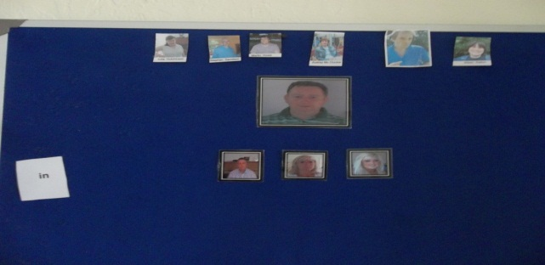
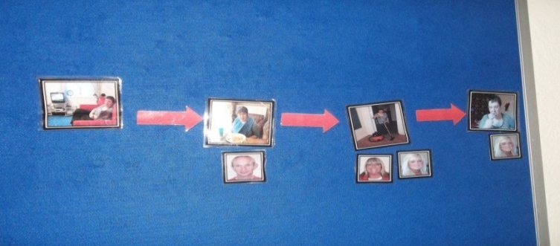
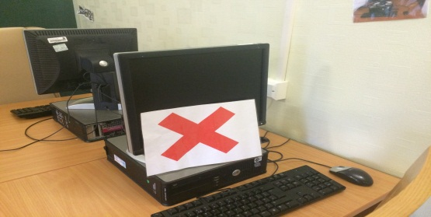
Visual supports. Examples that might be seen Reg. 9
Signs around the building, visual cues e.g. location of areas of the building, sometimes words or pictures
Staff boards
Case study- “D” understands finish by down the toilet.
Visual schedules
Symbols to indicate finish

Slide 7
Autism specific approach around communication and social interaction
Reg. 9
Staff sitting alongside people not saying anything. At mealtimes people may be quiet-staff may be encouraged not to talk or interact with a person if this works best for the person.
Firm tone which is assertive and to the point e.g. what’s next point to picture
Only one member of staff talking at once-other staying completely quiet
Conversation may be different. A person may say something to you in the way they want to hear it repeated back to them. They may repeat until you have said it in the way they want.
Lack of social graces so not to overload e.g. no good morning, how are you?

Slide 8
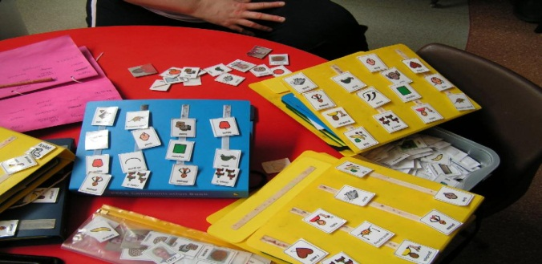
Autism specific approach around communication and social interaction?
Reg. 9
Exaggerated facial expressions may be seen used as individuals may need this to support understanding of language
Conversation may be different. A person may say something to you in the way they want to hear it repeated back to them. They may repeat until you have said it in the way they want.
Staff allowing service users lots of processing time-conversation may therefore appear unnatural and stilted
PECS
Makaton

Slide 9
Sensory and communicative needs combined: Reg 9
Case study:
M- long history of initiating touch.
Grabbing others hands ,parts of the
body and squeezing them, draping leg
over others legs ,and tapping his foot against others feet. etc.
Sensory assessments concluded that M has a need for tactile/proprioceptive input .
Touch was meeting both a sensory and communicative need.
However setting safe limits around touch has been important due to the ease with which initiated touch can be socially inappropriate for some people and has been known to cause minor injuries such as bruising and scratches.

Slide 10
Autism specific approach that still reflects preferences Reg 9
Repetitive ripping, shredding, lining things up, spinning, rocking may give the person reassurance and realignment. These behaviours will not be challenged.
Appropriate activities maybe not “age appropriate”. E.g. X is in his late 50s he has a jungle themed bedroom with toy cranes-this is his choice and works well for him.
Person Y is assessed to play with age 1-3 toys to develop his understanding of turn taking.
Case Studies

Slide 11
Reg 10-Dignity and respect
Includes
Ensuring the privacy of the service user
Supporting the autonomy, independence and involvement in the community of the service user

Slide 12
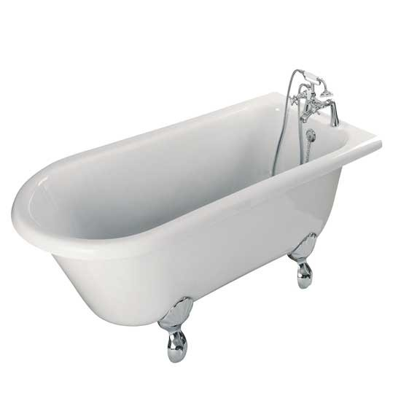
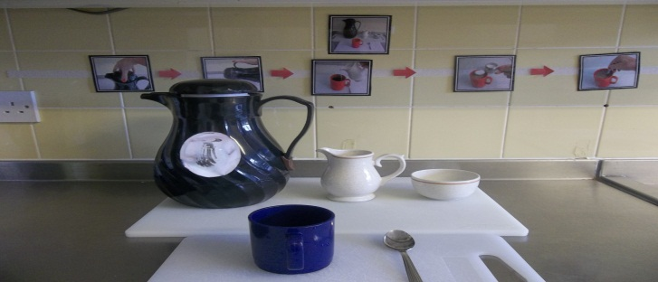
Autism specific approach that supports privacy of service user
Autism specific approach that supports autonomy, independence and involvement in the community
Lots of use of visual aids rather than “staff teaching”
Case study
Example: service user that walks behind member of staff
Washing up-routine.

Slide 13
Reg 11 Need for consent
Care and treatment of service users must only be provided with the consent of the relevant person.

Slide 14
Autism specific approach that supports assessment of capacity and consent
MCA and Best Interest decisions
Many individuals we support we don’t give any notice for activities as this may cause more anxiety e.g. holidays
Case study-M-physical prompt to assist transitions

Slide 15
Reg 12 Safe care and treatment
Includes-
Assessing the risks to the health and safety of service users of receiving the care and treatment
Doing all that is reasonably practicable to mitigate such risks
Ensuring that persons providing care and treatment have the qualifications, competence, skills and experience to do so safely

Slide 16
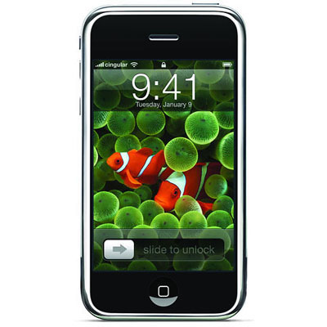
Autism specific approach that supports safe care and treatment
Commitment to training especially advanced autism
Autism introduction
Autism advanced
Teacch
Intensive Interaction
Studio 3
Safeguarding
Sensory
Case study- N and risk around phone

Slide 17
Reg. 13 Safeguarding service users from abuse and improper treatment
It must not be provided in a way that-
Includes acts intended to control or restrain a service user(either use of physical, mechanical or chemical means) that are not necessary to prevent, or not a proportionate response to, a risk of harm posed to the service user or another individual if the service user was to subject to control or restraint

Slide 18
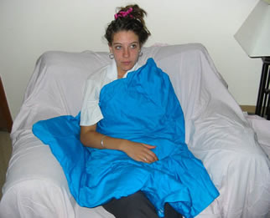
Autism specific approach that safeguards service users from abuse and improper treatment
Policy Statement
ESPA believes that every individual has the right to live and work in conditions which ensure they are free from abuse. We will work in collaboration with all relevant agencies to uphold the rights of the individual to ensure that they are protected from harm through abuse or exploitation
Medication is only given to individuals in ESPA for therapeutic or medical reasons. When medication is used in behaviour management this is alongside other interventions. All medication is reviewed regularly by Consultant Psychiatrists; the General Practitioner and the Multi-disciplinary Team.
Studio 3-low arousal approach
Low arousal attempts to avoid confrontation but where it is unavoidable the reactive plan will meet the persons needs no matter how inappropriately that need has been expressed.
“When person drowning we through them a life jacket not try and teach them to swim”
Clear guidance around use of therapeutic equipment

Slide 19
Reg. 14 Meeting nutritional and hydration needs of service users
Receipt by a service user of suitable and nutritious food and hydration which is adequate to sustain life and good health
The meeting of any reasonable requirements of a service user for food and hydration arising from the service users preferences or their religious or cultural backgrounds

Slide 20
Autism specific approach that meets nutritional and hydration needs of service users
Taste and smell senses are linked.
Over 50% of children with AS have
olfactory and taste sensitivity. Some may
insist on a very restricted diet. Many
cannot tolerate food types mixed together
or ‘wet’ textures.
Carrots in a green salad and celery in a
tuna fish salad are still intolerable to me
because the contrast in texture
between carrots or celery and salad or
tuna fish is too great. However, I still
enjoy eating celery and baby carrots by
themselves. (Shore 2001p.44)
Case study-Guinness at 10.30am
Case study-G-will only eat certain foods at specific locations . E.g. will only eat chicken nuggets at ESPA college

Slide 21
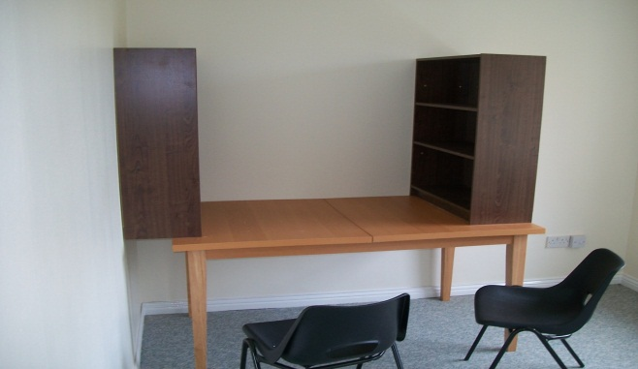
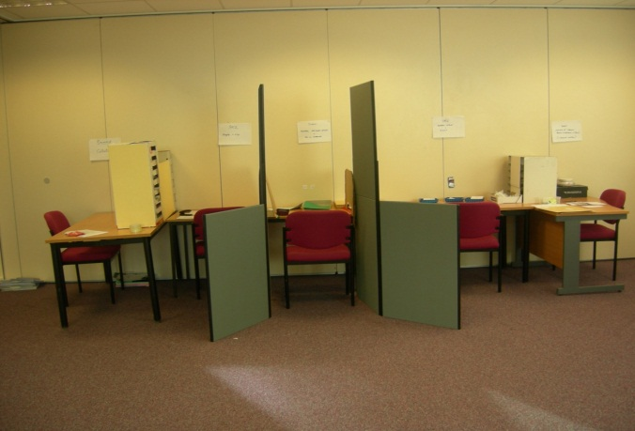
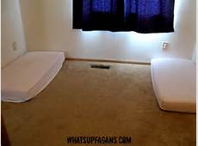
Reg. 15 Premises and equipment
Autism specific approach that concerns premises and equipment
TEACCH-physical environment may need to be very structured and often minimal in order give clarity to individual
Case study-M

Slide 22
Questions?

